Slide 1
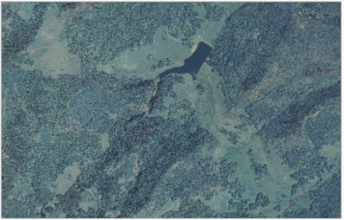
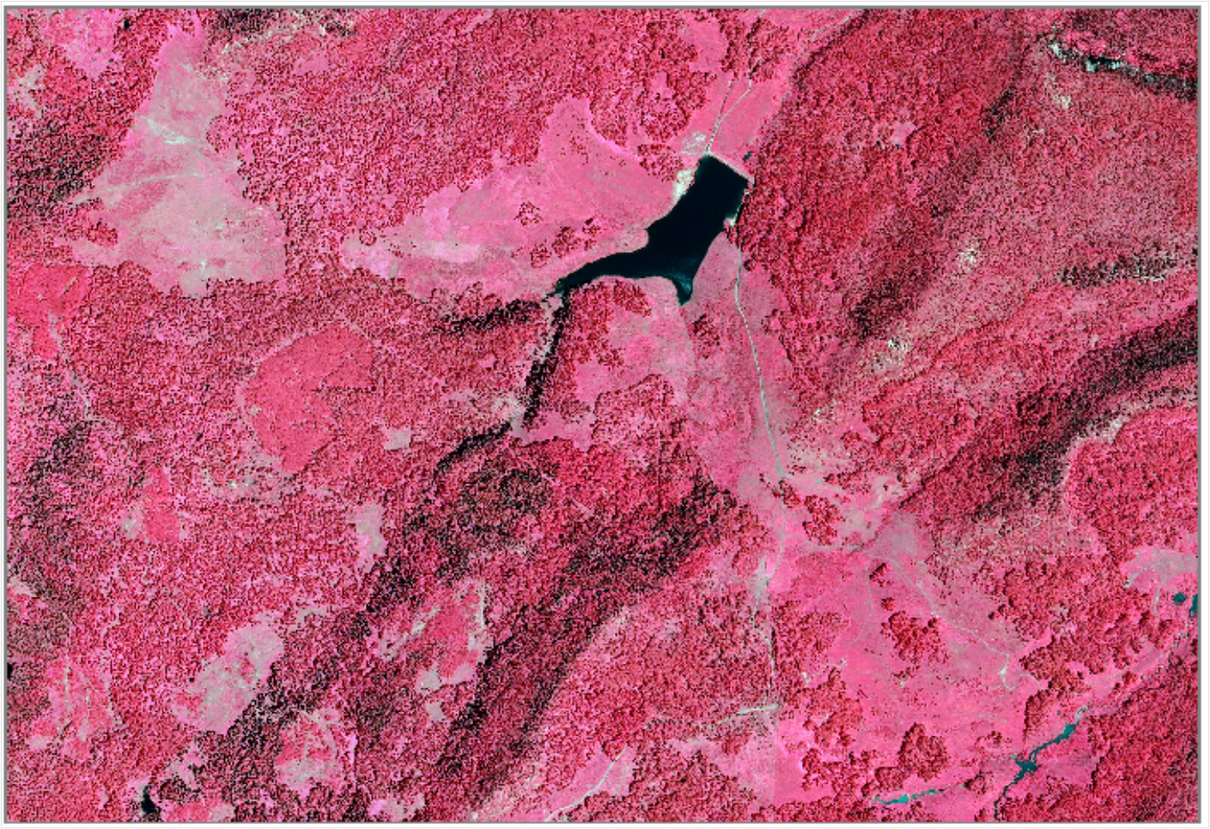
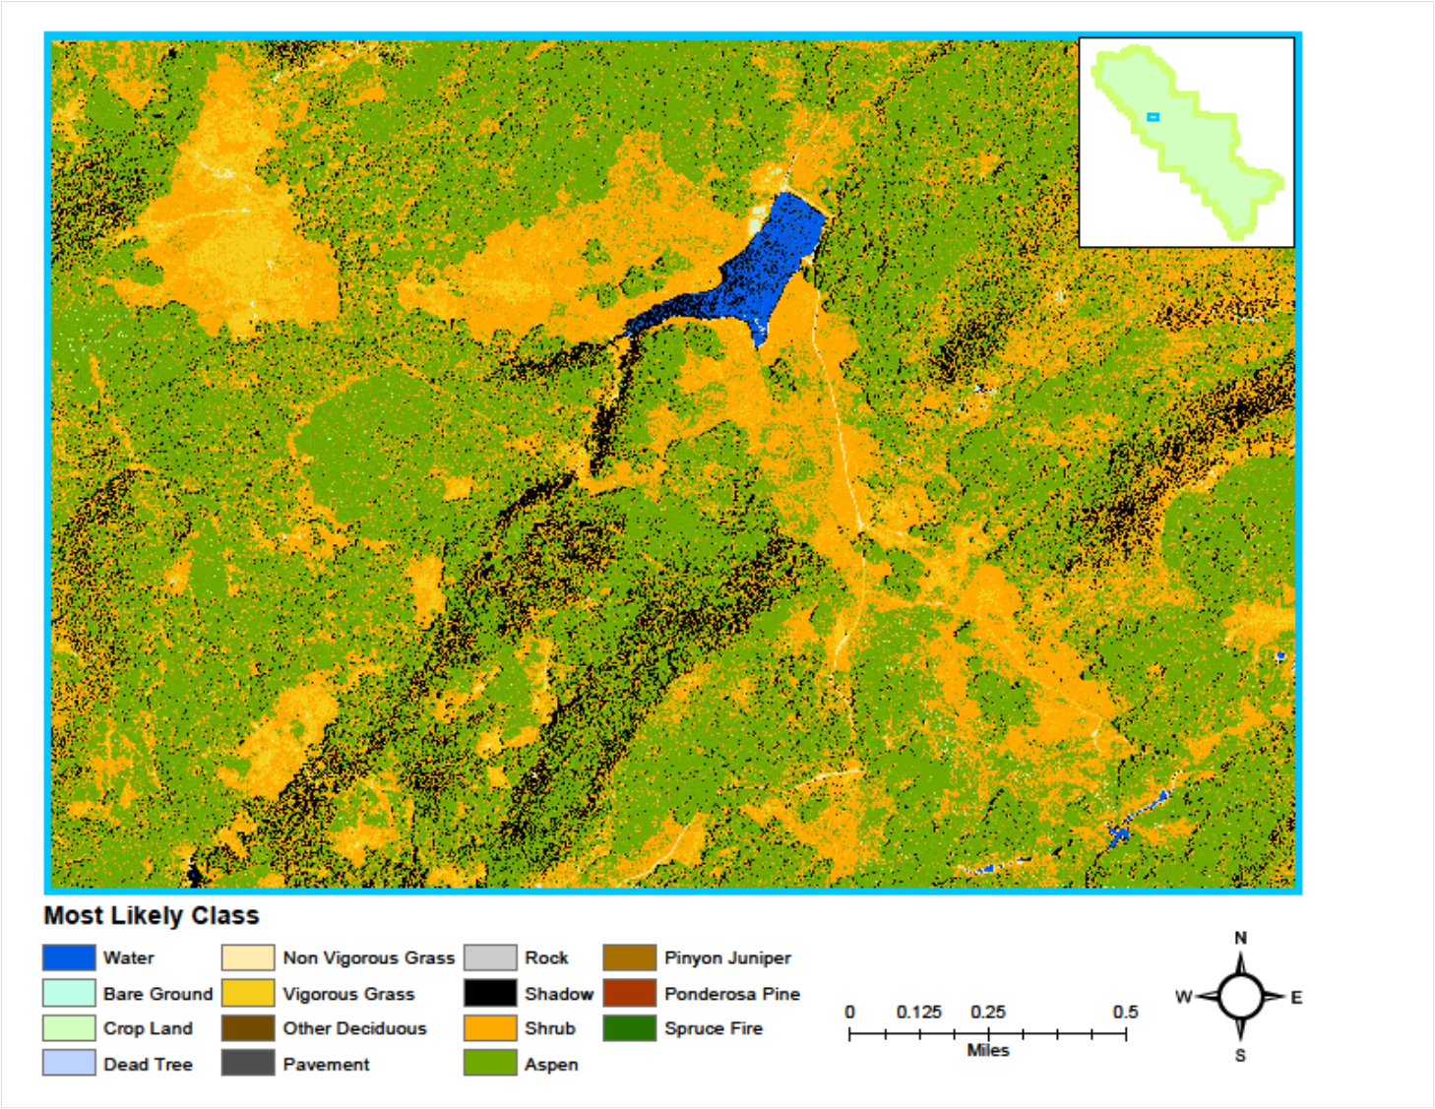

Data Acquisition

Slide 2
Data Acquisition

Slide 3
Data Acquisition

Slide 4
Data Acquisition

Slide 5
Data Acquisition

Slide 6
Data Acquisition

Slide 7
Data Acquisition

Slide 8
Data Acquisition

Slide 9
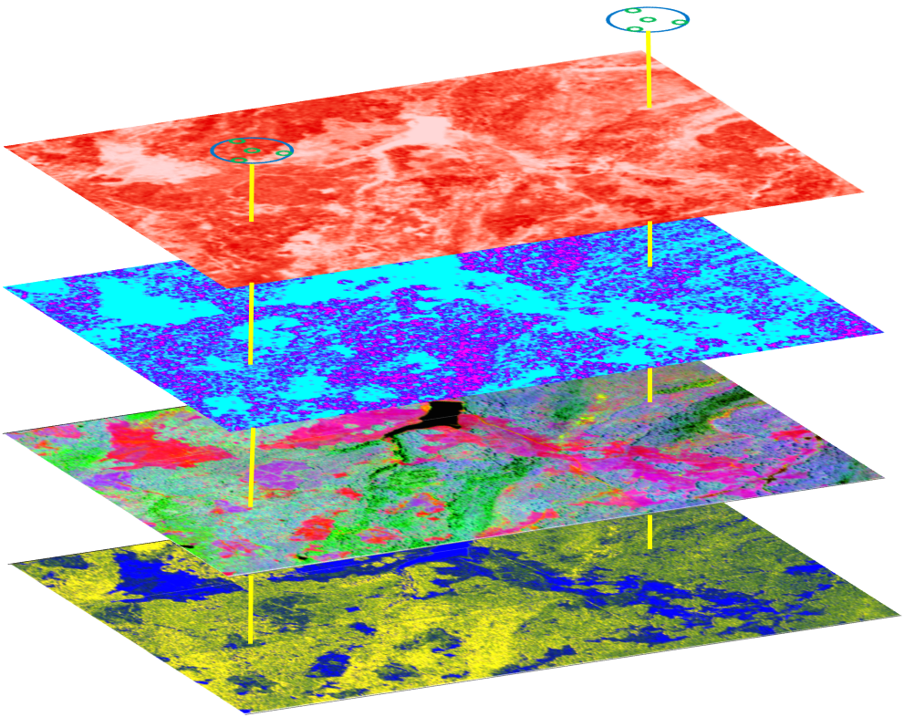
Sampling

Slide 10
Sampling

Slide 11
Sampling

Slide 12
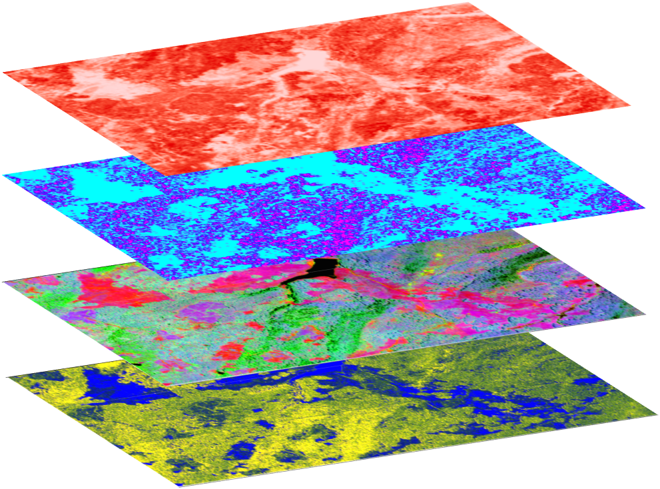
Sampling

Slide 13
Sampling

Slide 14
Sampling

Slide 15
Sampling

Slide 16
Sampling

Slide 17
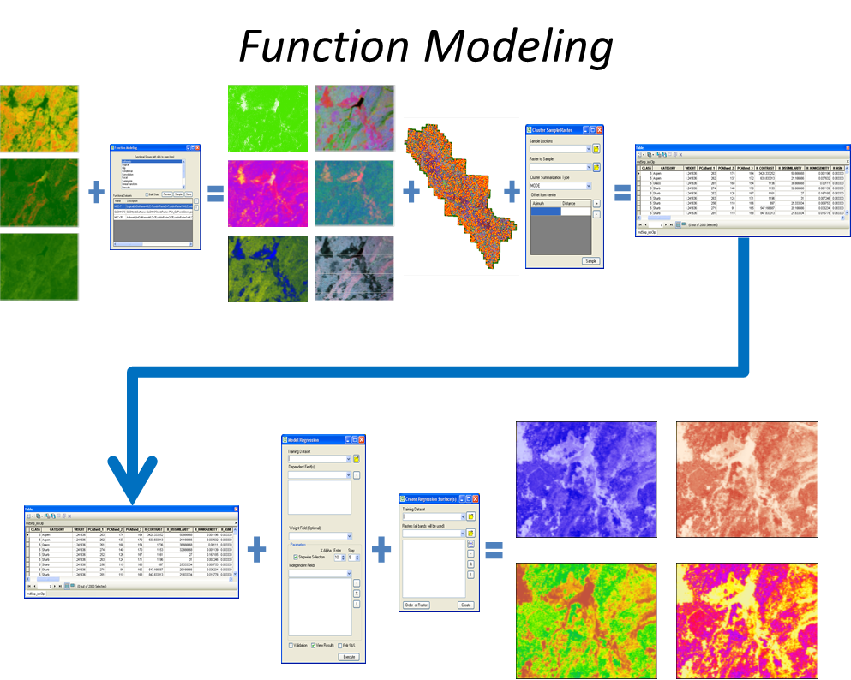

Slide 20


Slide 21
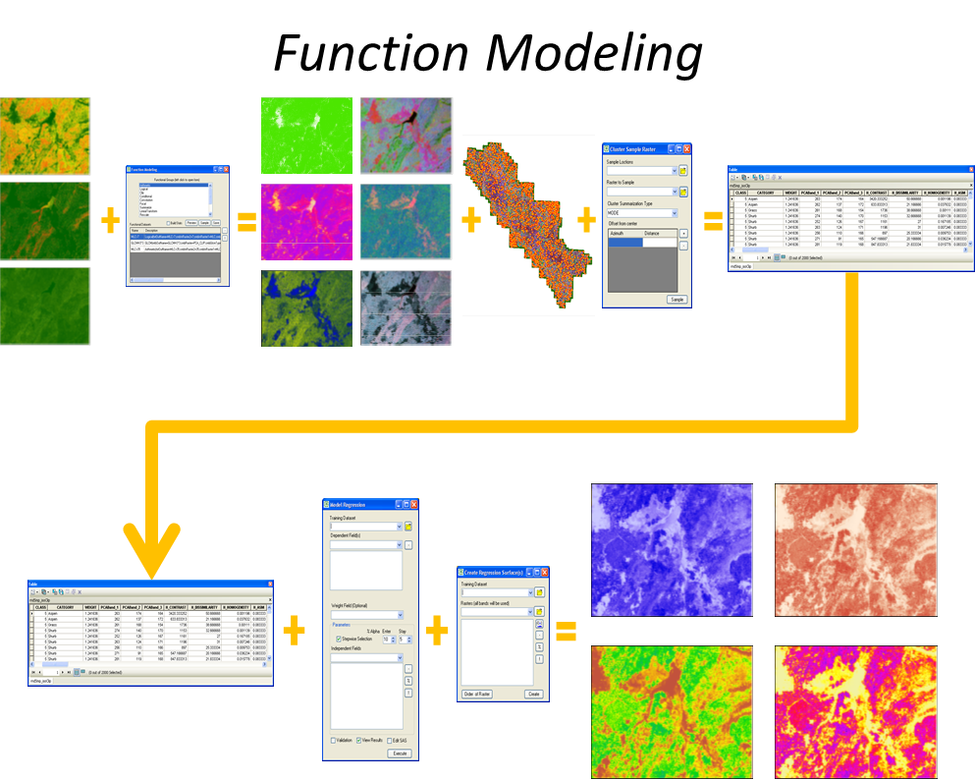

Slide 22
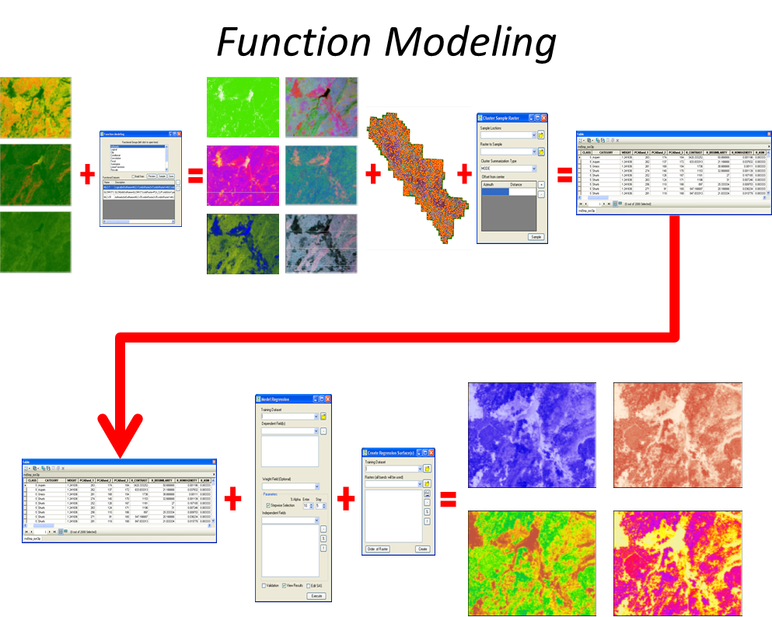

Slide 25
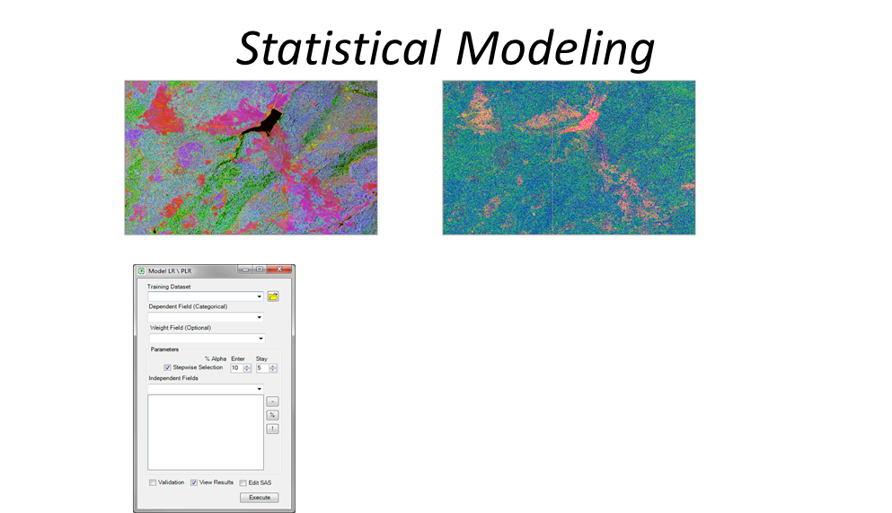

Slide 28
